Slide 1
PROPERTY & PLANNING
FEBRUARY 2024 UPDATE
H PAUL SHACKLETON- CHAIR
919-210-7487

Slide 2
MERIDIAN CARY PROJECT – UPDATED - ESTIMATED SCHEDULE AS OF 2/2/24
SITE WORK –PHASE 2 | START |  | COMPLETE (NEW EST)
PARKING DECK – SITE PREP & FOUNDATION | 8/14/2023 | 215 | 3/16/2024
ACADEMY STREET PARKING DECK ENTRANCE | 3/25/2024 | 120 | 7/23/2024
PARKING DECK – ERECTION | 3/15/2024 | 145 | 8/7/2024
MULTIFAMILY CONSTRUCTION
PARKING DECK FAÇADE MULTIFAMILY CONSTRUCTION CHURCH PARKING – NORTH SIDE - PARK ST LOT | 8/8/2024 8/7/2024 7/24/2024 | 60 550 80 | 10/7/2024 12/9/2025 10/12/2024

Slide 3
PROPERTY & PLANNING - COMMUNICATION
P&P TEAM MEMBERS MEET AS NEEDED WITH NORTHVIEW CONSTRUCTION GTEAM
P&P KEEPS A LIST OF ITEMS NEEDING ATTENTION AND REVIEWS PERIODICALLY WITH NORTHVIEW
P&P WILL CONTINUE TO UPDATE THE CHURCH AS NEEDED AT CHURCH CONFERENCE AND VIA THIS WEBSITE

Slide 4
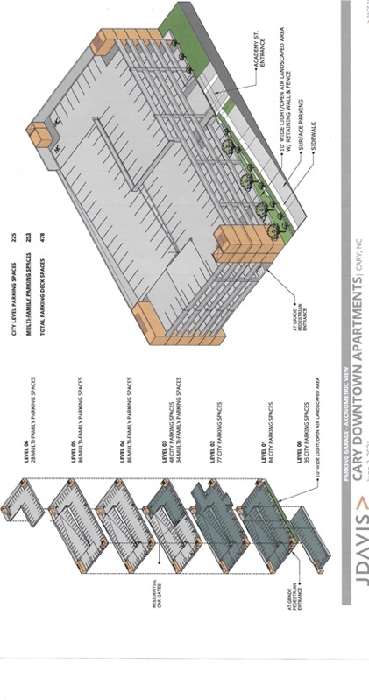
PARKING DECK RENDITION

Slide 5
PROPERTY & PLANNING COMMITTEE TEAM
PAUL SHACKLETON – CHAIR
SUE LANIER
JAMES PHILLIPS
JOHN SHUPE
PHYLLIS TIPTON
ANTHONY WOOD
REV MYRON BURRIS – STAFF LIAISON
CHRIS BROWN – CONSULTANT TO COMMITTEE
RYAN MADISON – B&F CHAIR
STEVEN SCOTT – DEACON AD-HOC COMMUNICATION

